Slide 1
CMOS Circuit and Logic Design*
CMOS Logic Gate Design:
  Is the design logically functional?
    Adequate power supply connections
    Noise margins OK
    Transistors and connections
    Device ratios (for ratio’ed circuits)
    Charge sharing problems (for dynamic circuits)
  Is the design timed properly?
    Critical paths within specified limits
    Race conditions
Various levels of design to understand:
  Architectural level
    Good design starts with the architecture!
  RTL (logic gate) level
  Circuit design (structural) level
  Layout level (physical design)
Net Delay: Delay = k C_{load}/β_{eff} V_{DD}
where k = ~1.5-2 for delay, 2-4 for rise/fall time
* Chapter 7 in Kang and Leblebici
+ Chapter 5 in Weste and Eshraghian
R. W. Knepper
SC571, page 5-1

Slide 2
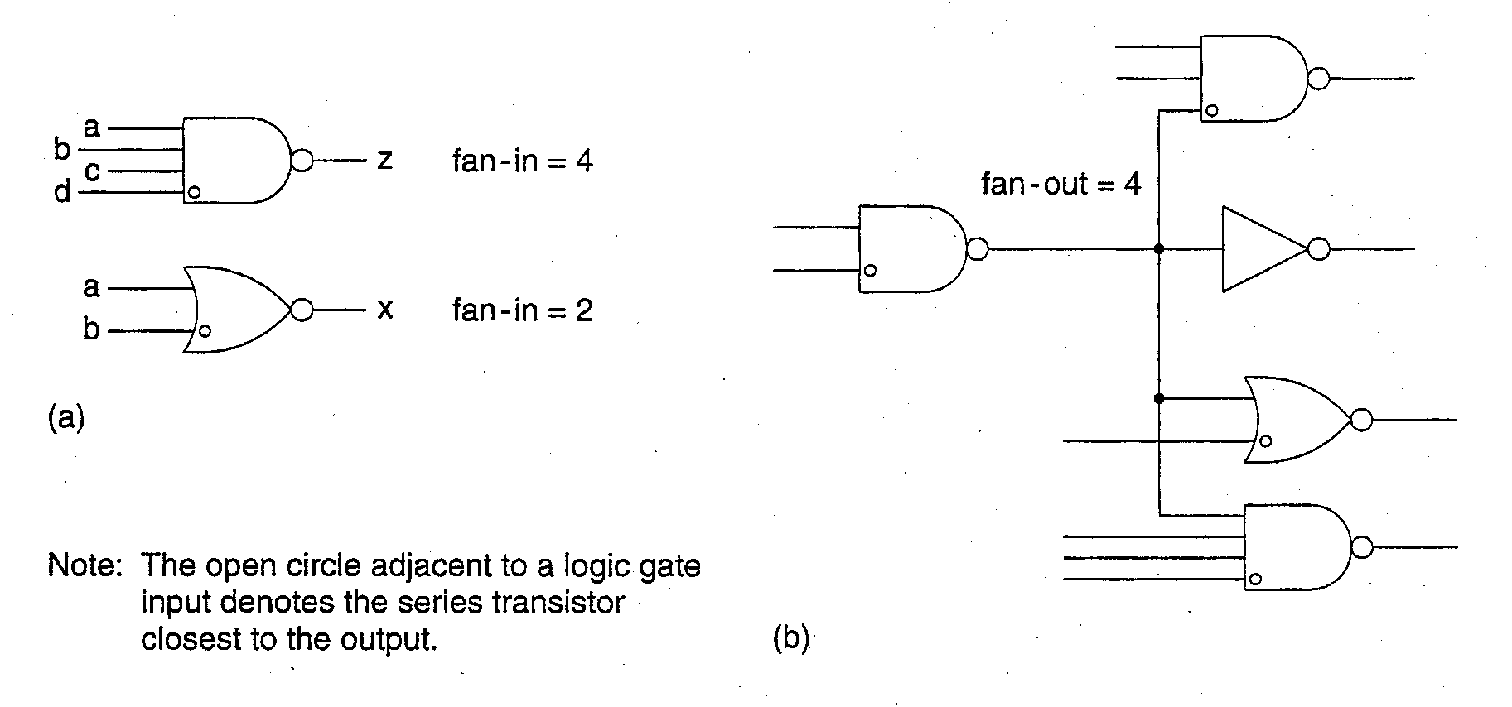
Definition of Fan-In and Fan-Out
Fan-In = number of inputs to a logic gate
  4 input NAND has a FI = 4
  2 input NOR has a FI = 2, etc. (See Fig. a below.)
Fan-Out = number of gate inputs which are driven by a particular gate output
  FO = 4 in Fig. b below shows an output wire feeding an input on four different logic gates
The circuit delay of a gate is a function of both the Fan-In and the Fan-Out.
Ex. m-input NAND: t_{dr} = (R_{p}/n)(mnC_{d} + C_{r} + kC_{g})
= t_{internal-r} + k t_{output-r}
  where n = width multiplier, m = fan-in, k = fan-out, Rp = resistance of min inverter P Tx, Cg = gate capacitance, Cd = source/drain capac, Cr = routing (wiring) capac.
R. W. Knepper
SC571, page 5-2

Slide 3
Definition of Fan-In and Fan-Out (continued)
The circuit fall delay can be written in a similar manner.
Ex. m-input NAND: t_{df} = m(R_{n}/n)(mnC_{d} + C_{r} + kC_{g})
= t_{internal-f} + k t_{output-f}
  where n = width multiplier, m = fan-in, k = fan-out, Rn = resistance of min inverter NMOS Tx, Cg = gate capacitance, Cd = source/drain capac, Cr = routing (wiring) capac.
  If we set t_{dr} = t_{df} for the case of symmetrical rise and fall delay, we obtain that Rp = m Rn and therefore,
  β_{p}W_{p} = (β_{n}W_{n})/m
R. W. Knepper
SC571, page 5-3

Slide 4
CMOS Technology Logic Circuit Structures
Many different logic circuits utilizing CMOS technology have been invented and used in various applications. These can be divided into three types or families of circuits:
  Complementary Logic
    Standard CMOS
    Clocked CMOS (C²MOS)
    BICMOS (CMOS logic with Bipolar driver)
  Ratio Circuit Logic
    Pseudo-NMOS
    Saturated NMOS Load
    Saturated PMOS Load
    Depletion NMOS Load (E/D)
    Source Follower Pull-up Logic (SFPL)
  Dynamic Logic:
    CMOS Domino Logic
    NP Domino Logic (also called Zipper CMOS)
    NORA Logic
    Cascade voltage Switch Logic (CVSL)
    Sample-Set Differential Logic (SSDL)
    Pass-Transistor Logic
R. W. Knepper
SC571, page 5-4

Slide 5
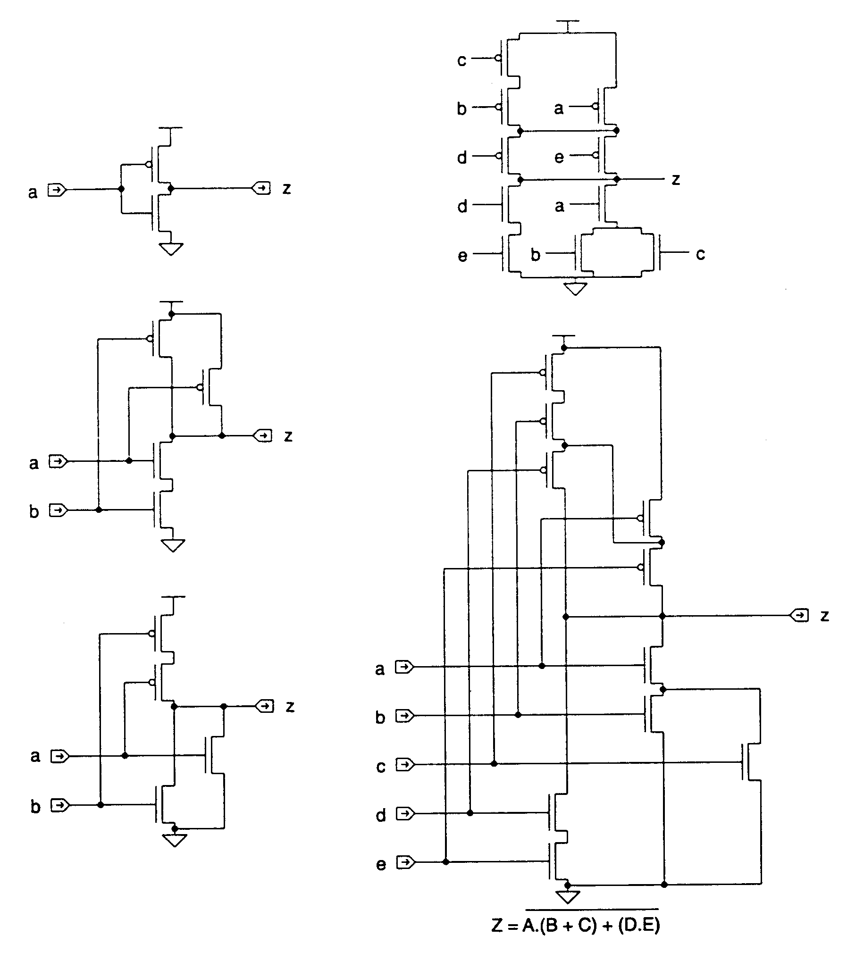
Logic Circuit Types: CMOS Complementary Logic
CMOS Complementary Logic Circuits:
  inverter
  2-input NAND
  2-NOR showing position of poly gates
  complex logic gate [A(B+C)+(DE)]’ showing position of poly gates by ordering of device inputs
Each logic function is duplicated for both pull-down and pull-up logic tree
  pull-down tree gives the zero entries of the truth table, i.e. implements the negative of the given function Z
  pull-up tree is the dual of the pull-down tree, i.e. implements the true logic with each input negative-going
Advantages: low power, high noise margins, design ease, functionality
Disadvantage: high input capacitance reduces the ultimate performance
R. W. Knepper
SC571, page 5-5

Slide 6
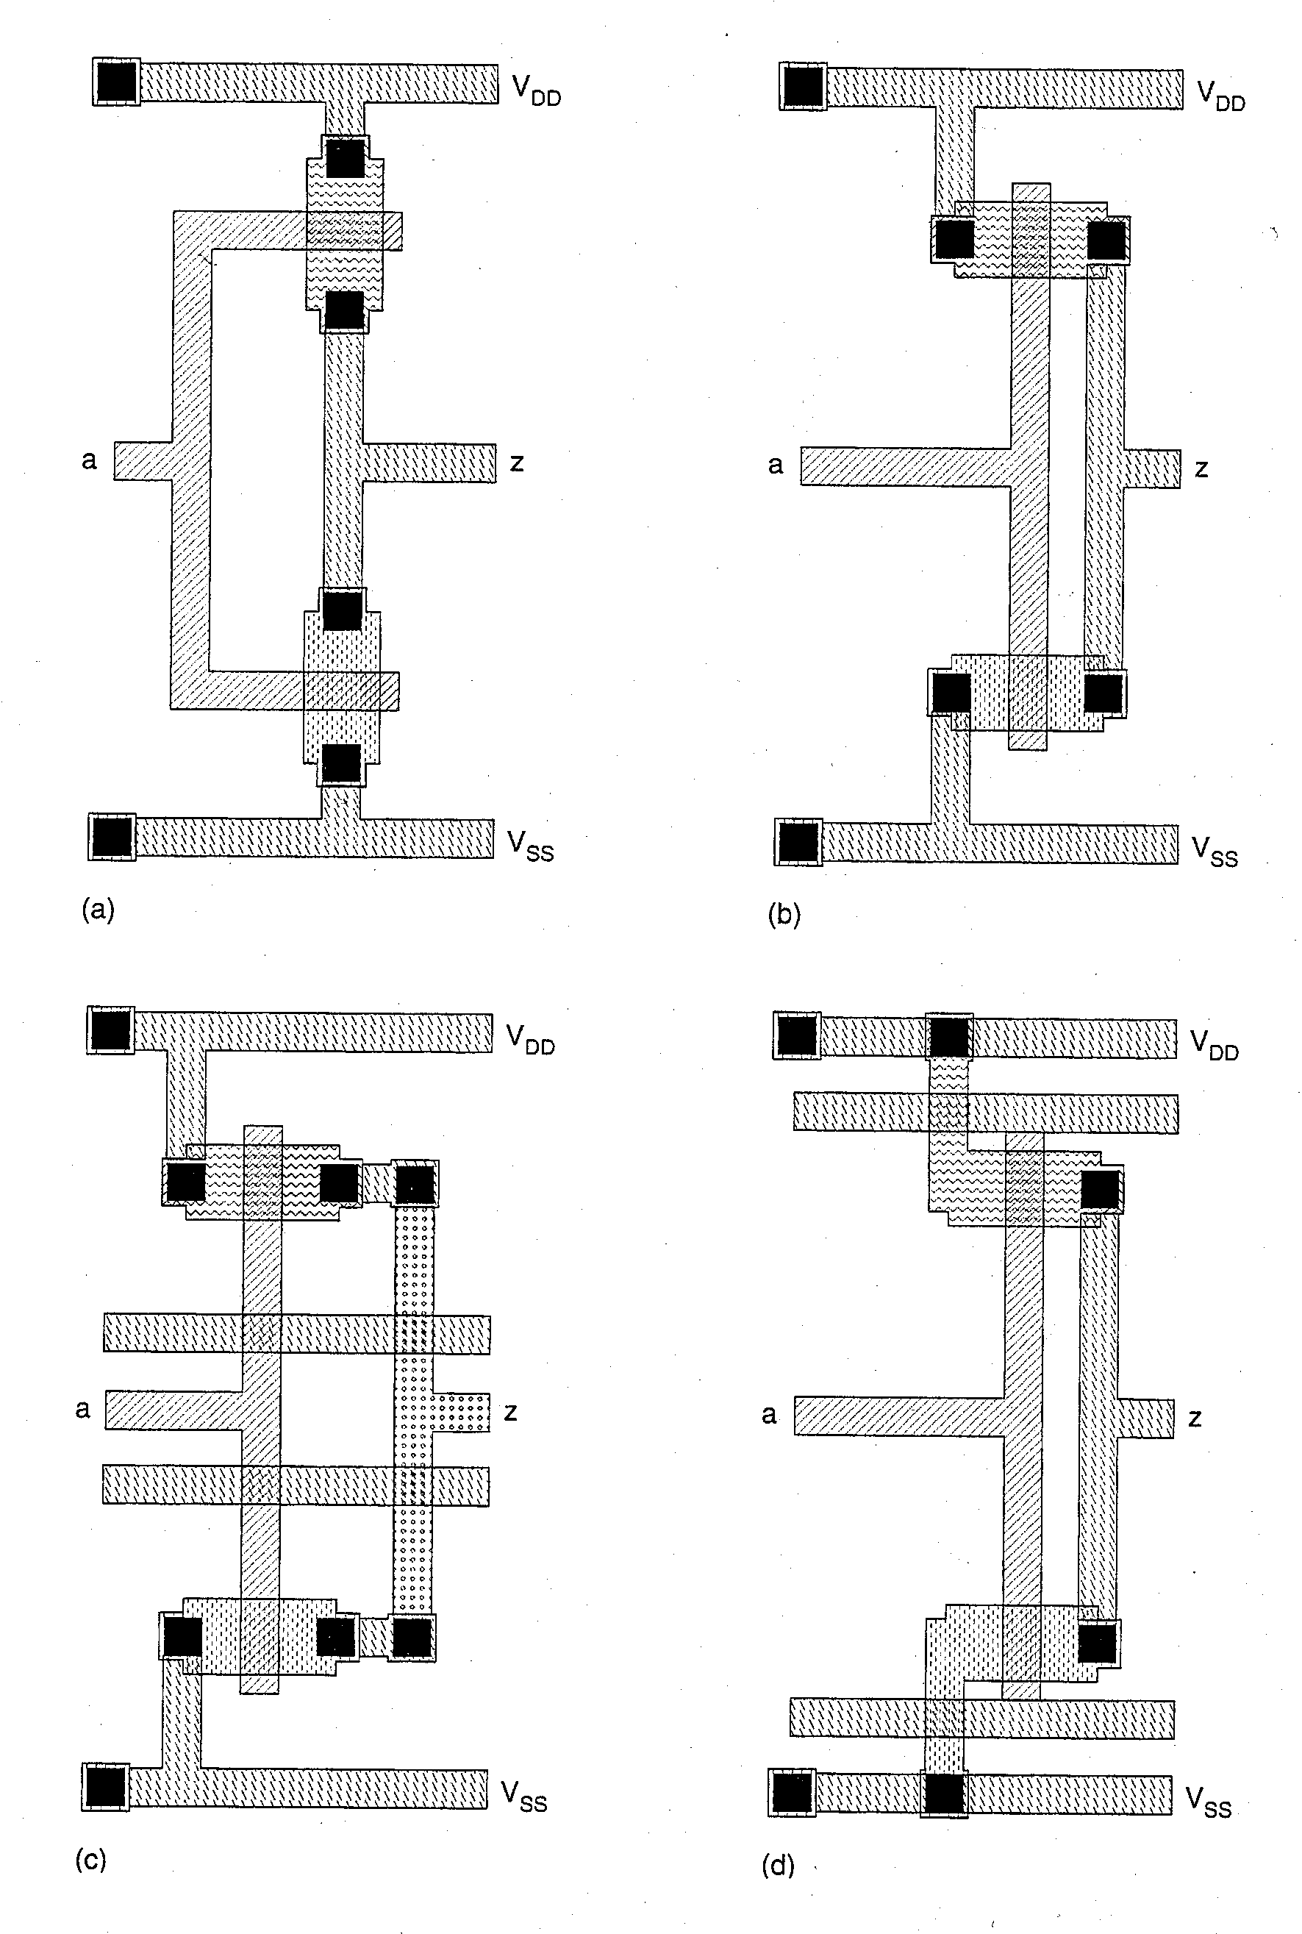
Various CMOS Inverter Symbolic Layouts
(a) shows symbolic layout of inverter corresponding to symbolic schematic on page 5-5
(b) is alternate inverter layout showing horizontal active areas with vertical poly stripe for gates and vertical metal drain connections
(c) uses M2 metal to connect transistor drains in order to allow passing horizontal M1 metal wires
(d ) uses diffused N & P source region extensions (active mask) to Vss and Vdd, respectively, in order to allow passing M1 metal wires at top and bottom of cell
R. W. Knepper
SC571, page 5-6

Slide 7
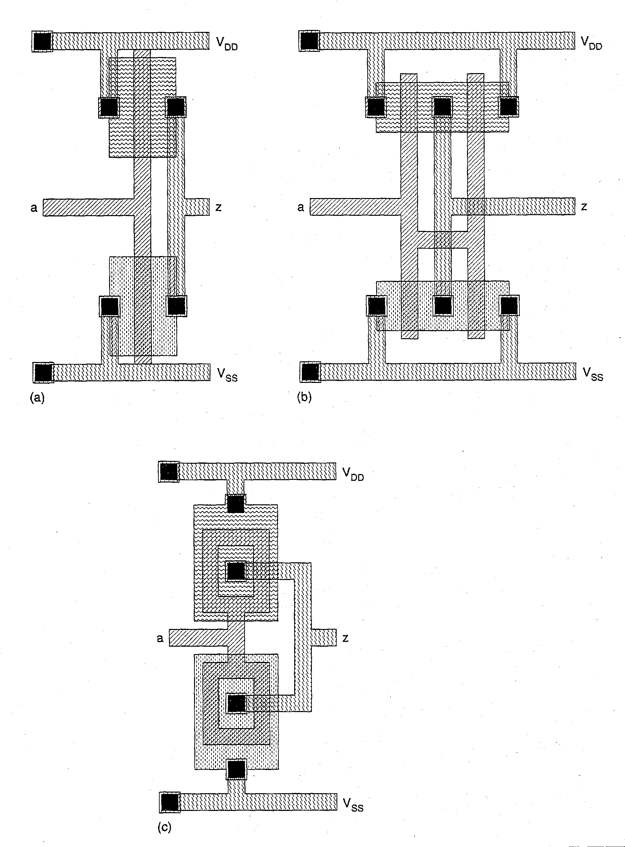
Alternate Methods for Creating Inverter Layouts
Option (a): increase the Wn and Wp beyond the min values
Option (b): use parallel sections to obtain increased Wn and Wp
  Stitch Vdd and Vss in such a way as to share the drain regions between parallel device sections
Option (c): use of “circular” transistors effectively quadruples the available channel width of each device
  Since the drain regions are in the center, the drain capacitance terms are minimum
R. W. Knepper
SC571, page 5-7

Slide 8
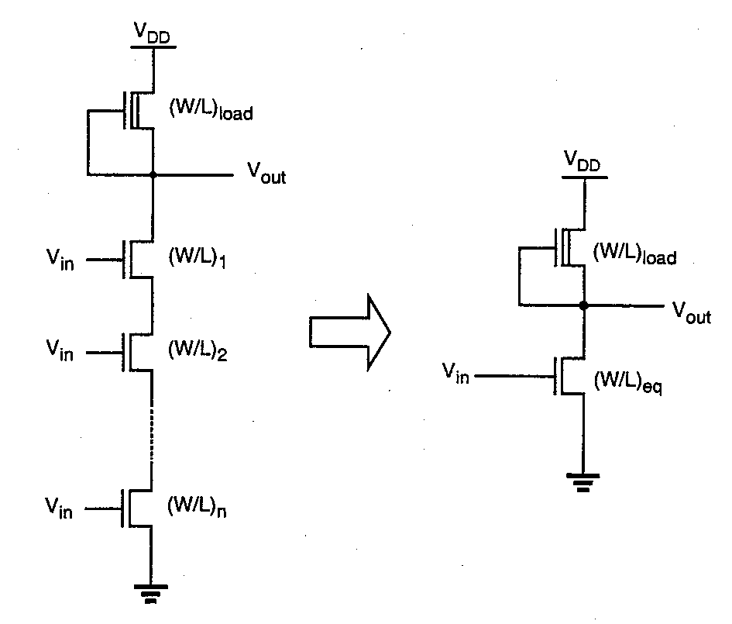
Generalized NAND Structure and Equivalent
An n-input NAND (shown at the left in NMOS depletion load logic) can be thought of as a simple inverter with the pull-down NMOS W/L given by
  (W/L)_{equivalent} = (1/n) x (W/L)_{NAND}
  where we have assumed that all the NAND pull-down transistors have the same W/L
For a ratio type NAND gate (such as the depletion load circuit shown), the active pull-down devices must be ratioed larger by n in order to retain an acceptable V_{OL}
  Assuming V_{OL} is determined for the inverter circuit, the n-input NAND would require each pull-down transistor to have W/L = n (W/L)_{eq} to achieve the same V_{OL} as the inverter.
  The layout area of the n-NAND would be roughly n² times the inverter area, neglecting the area of the depletion load.
R. W. Knepper
SC571, page 5-8

Slide 9
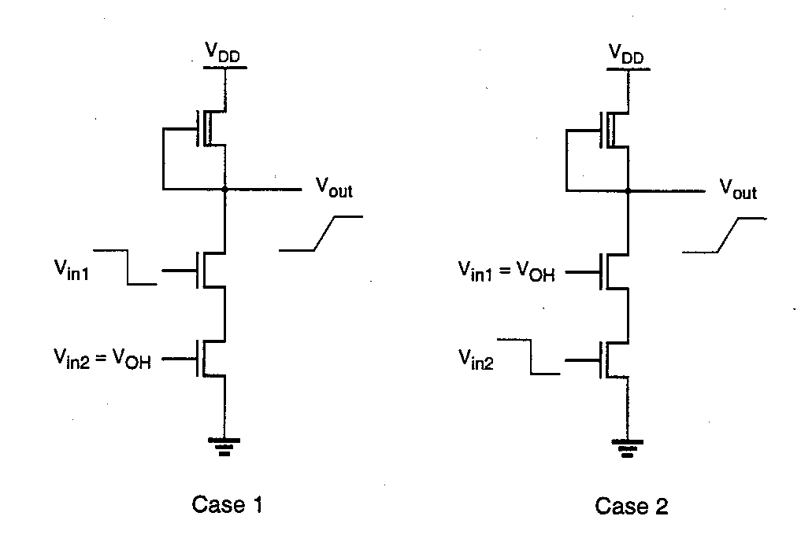
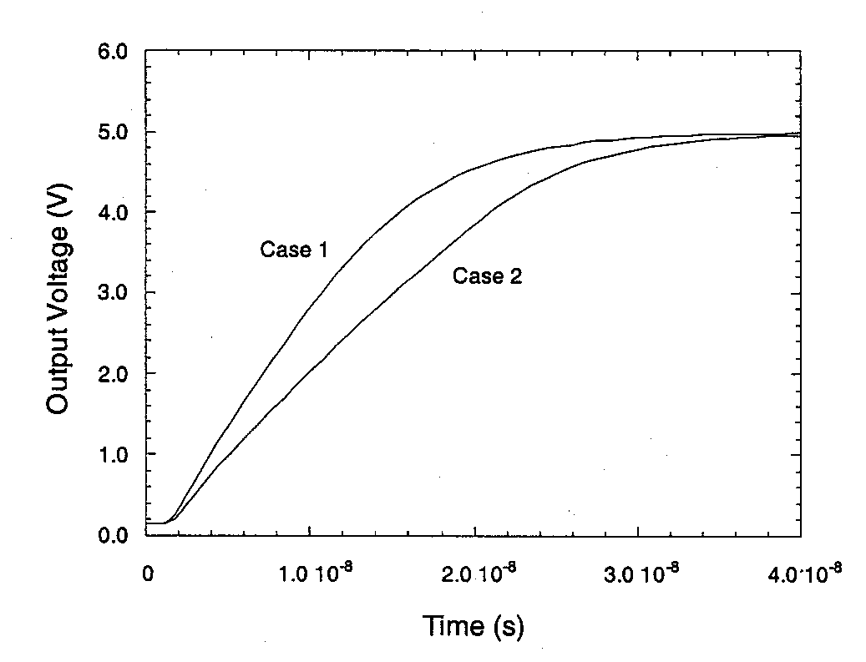
Output Rise Time Dependency on Input Switching
A dependency of the output rise time and low-to-high propagation delay with input switching order can be seen in the simulation results below.
  In case 1 pull-down device T2 has its gate brought to gnd while T1 remains ON with its gate at V_{DD}
  In case 2 T1 is the device switched OFF while T2 remains ON with its gate at V_{DD}
  Simulated output responses, shown below at the left, clearly show case 2 as the slowest with an additional 5 ns of propagation delay
Why is case 2 slower?
  Case 2 has additional capacitance on the internal node which charges to V_{DD} – V_{T} which takes some of the charging current normally going into C_{L}
R. W. Knepper
SC571, page 5-9

Slide 10
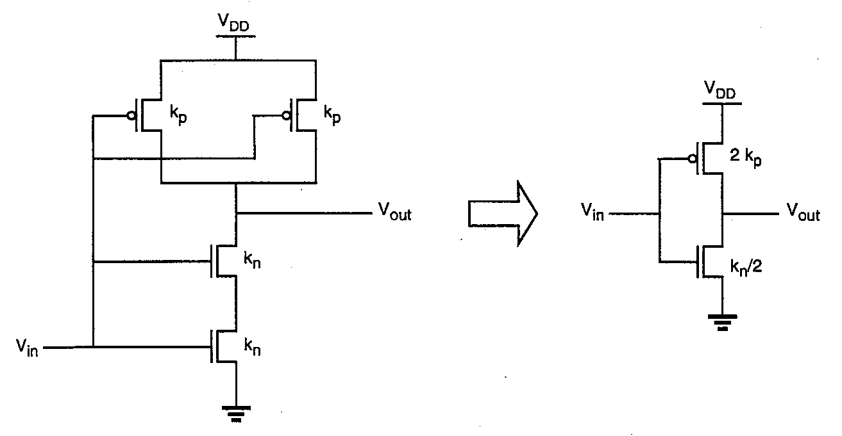
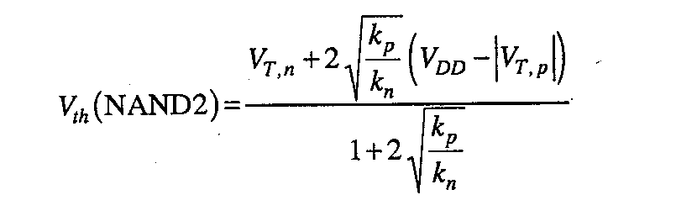
CMOS 2-Input NAND Gate and Inverter “Equivalent”
Compare the CMOS 2-input NAND gate with both inputs switching with a simple CMOS inverter (as shown at left)
  Assume both NMOS devices have the same W/L (and the same for both PMOS)
  The CMOS inverter “equivalent” would have an NMOS pull-down device of gain factor k_{n}/2 and a PMOS pull-up device of 2k_{p} to achieve equivalent delay and rise/fall times
An analysis of the dc voltage transfer curve, obtained by setting the currents in the NMOS and PMOS transistors equal, yields the switching threshold equation at the left.
  Note that if k_{n} = k_{p} (and V_{Tn} = |V_{Tp}|), we have Vth = 2/3 V_{DD} – 1/3 |V_{Tp}|
  To have Vth = ½ V_{DD}, we need k_{n} = 4 k_{p}
  A good compromise might be k_{n} = 2 k_{p}
R. W. Knepper
SC571, page 5-10

Slide 11
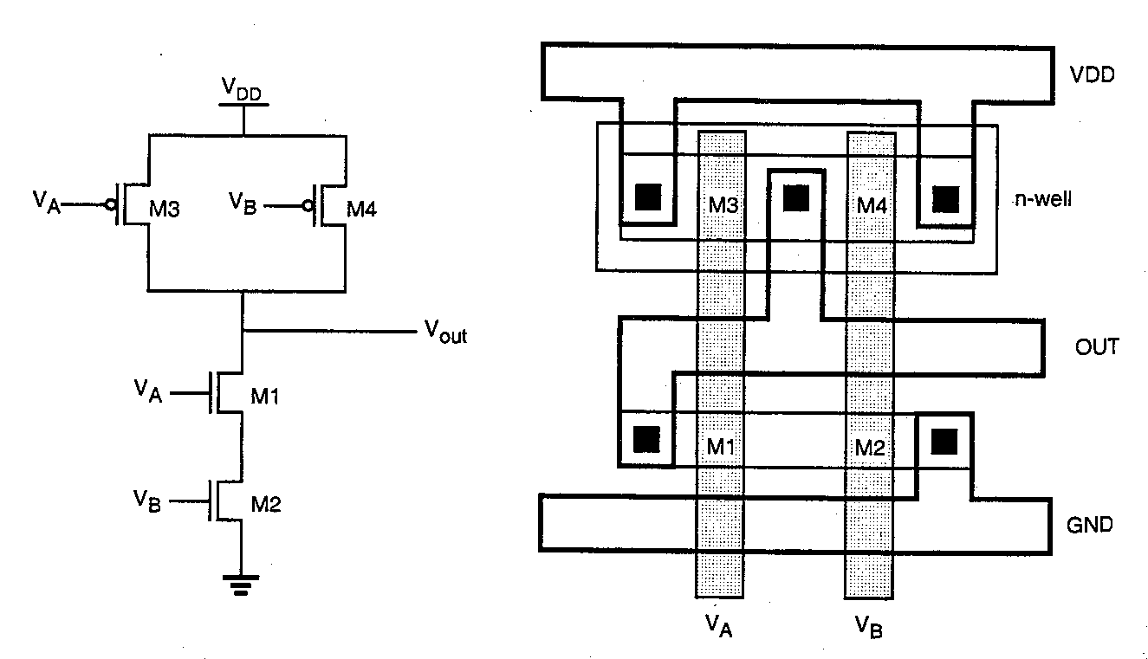
CMOS 2-NAND with Layout
The CMOS 2-NAND circuit and an example layout are shown below.
Attractive layout features:
  Single polysilicon lines (for inputs) are run vertically across both N and P active regions
  Single active shapes are used for building both NMOS devices and both PMOS devices
  Power bussing is running horizontal across top and bottom of layout
  Output wire runs horizontal for easy connection to neighboring circuit
R. W. Knepper
SC571, page 5-11

Slide 12
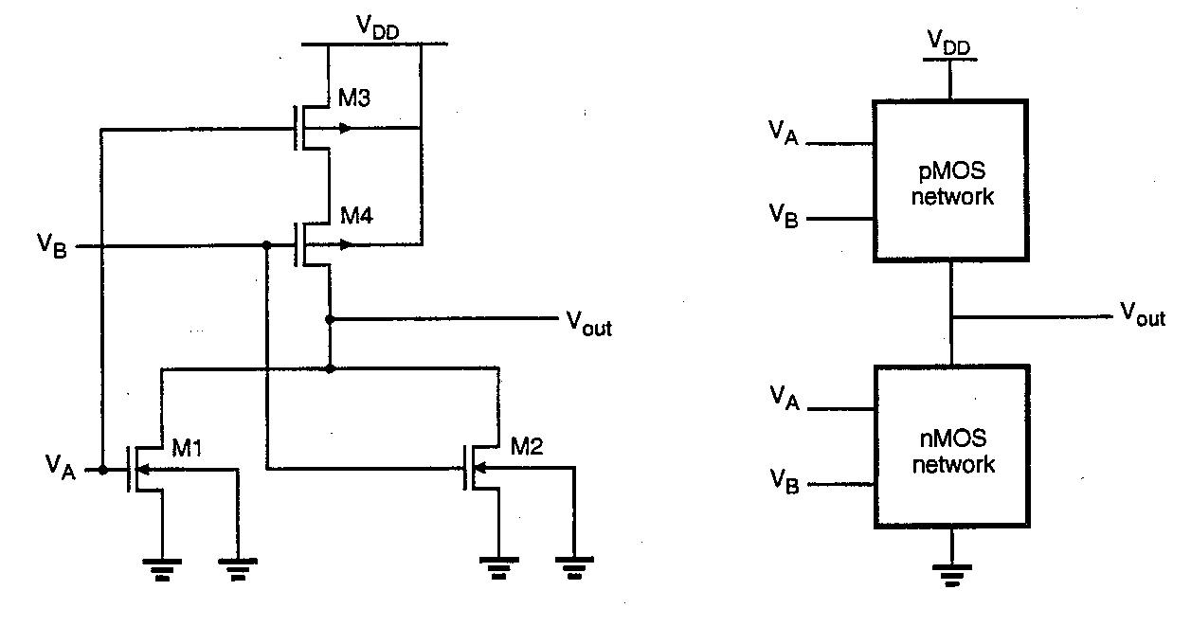
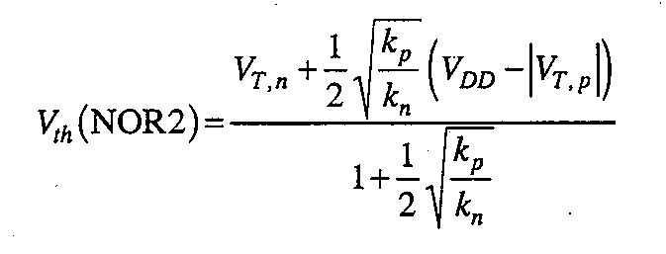
CMOS 2-input NOR Gate and Equivalent
A treatment of the 2-input NOR gate (similar to 2-input NAND) yields a switching threshold equation shown below, where the assumption is made that both inputs are switching at the same time.
Again, if V_{Tn} = |V_{Tp}| and k_{n} = k_{p}, then Vth = (V_{DD} + V_{Tn})/3
To obtain Vth = ½ V_{DD}, we would need to set k_{p} = 4 k_{n}
R. W. Knepper
SC571, page 5-12

Slide 13
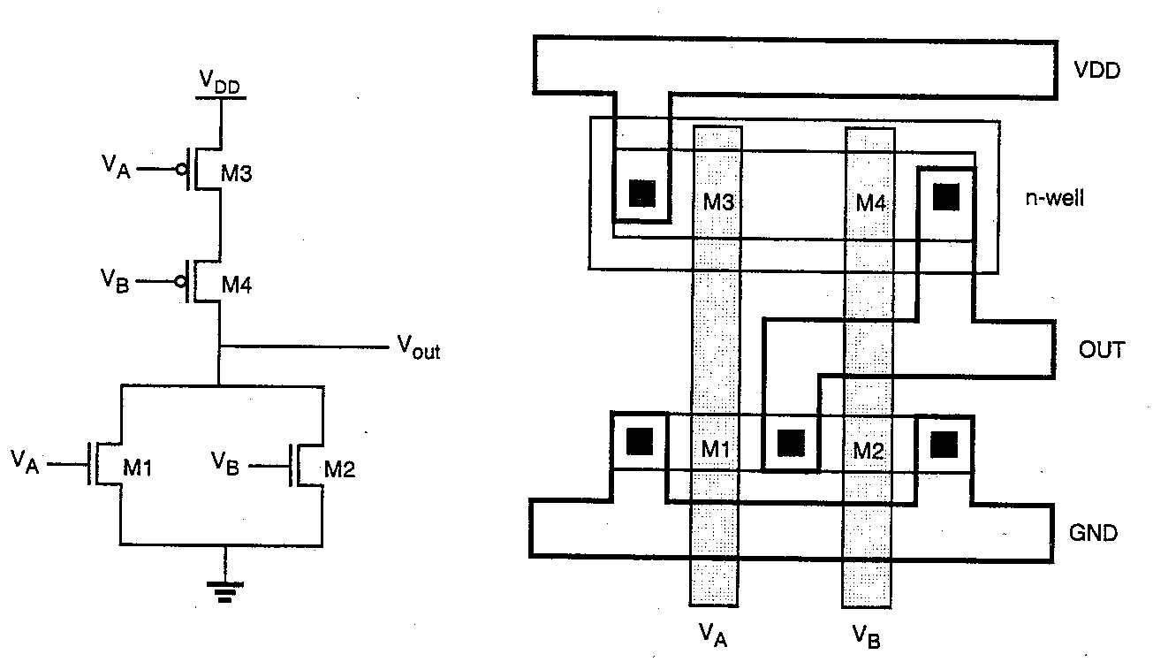
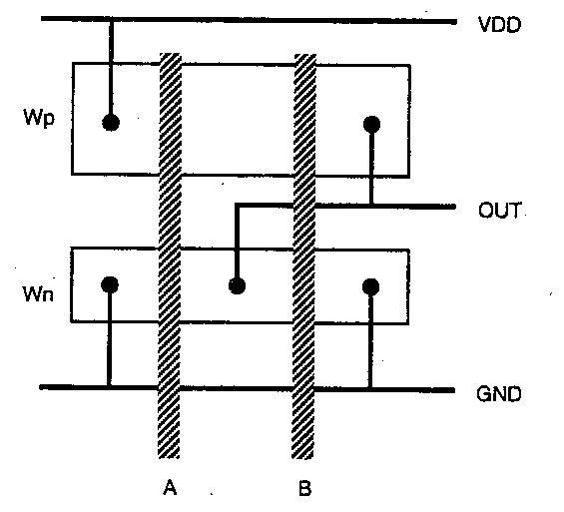
CMOS 2-Input NOR with Layout
Shown below is the CMOS 2-input NOR schematic with an example layout
Features of the layout are similar to the 2-input NAND
  Single vertical poly lines for each input
  Single active shapes for N and P devices, respectively
  Metal busing running horizontal
Also shown is a stick figure diagram for the NOR2 which corresponds directly to the layout, but does not contain W and L information
  Stick figure diagram is useful for planning optimum layout topology
R. W. Knepper
SC571, page 5-13

Slide 14
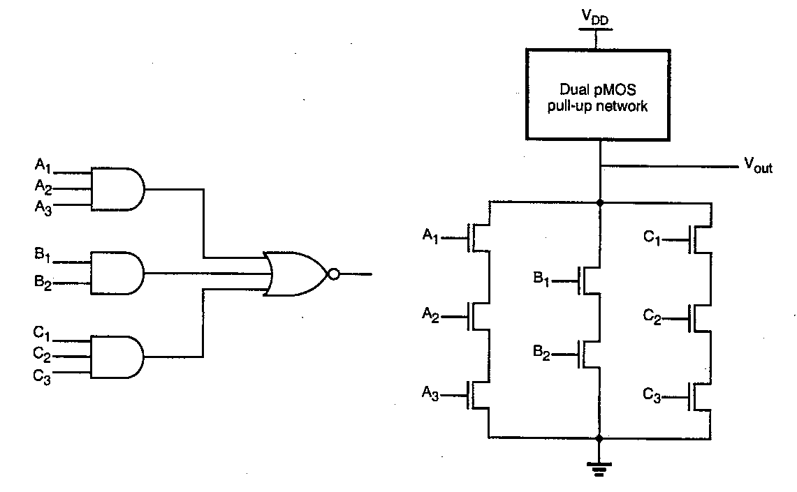
AOI (AND-OR-INVERT) CMOS Gate
AOI complex CMOS gate can be used to directly implement a sum-of-products Boolean function
The pull-down N-tree can be implemented as follows:
  Product terms yield series-connected NMOS transistors
  Sums are denoted by parallel-connected legs
  The complete function must be an inverted representation
The pull-up P-tree is derived as the dual of the N-tree
R. W. Knepper
SC571, page 5-14

Slide 15
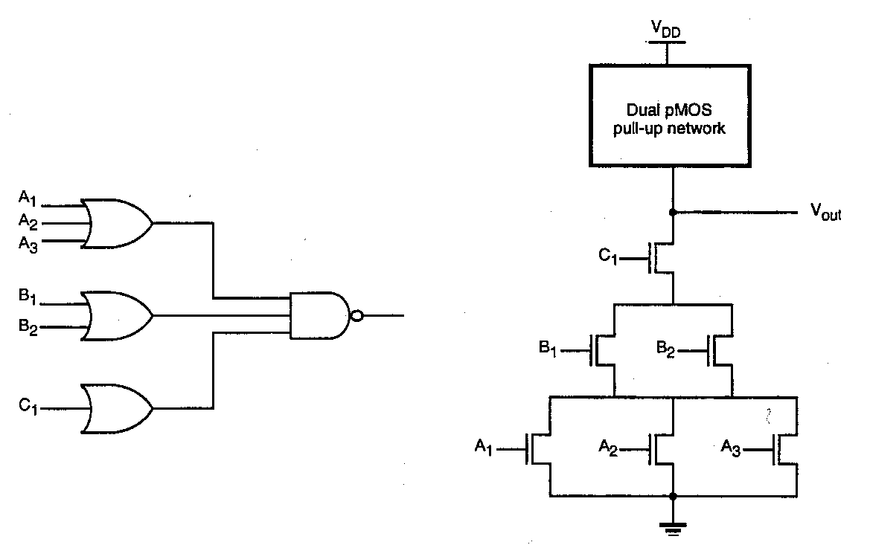
OAI (OR-AND-INVERT) CMOS Gate
An Or-And-Invert (OAI) CMOS gate is similar to the AOI gate except that it is an implementation of product-of-sums realization of a function
The N-tree is implemented as follows:
  Each product term is a set of parallel transistors for each input in the term
  All product terms (parallel groups) are put in series
  The complete function is again assumed to be an inverted representation
The P-tree can be implemented as the dual of the N-tree
Note: AO and OA gates (non-inverted function representation) can be implemented directly on the P-tree if inverted inputs are available
R. W. Knepper
SC571, page 5-15

Slide 16
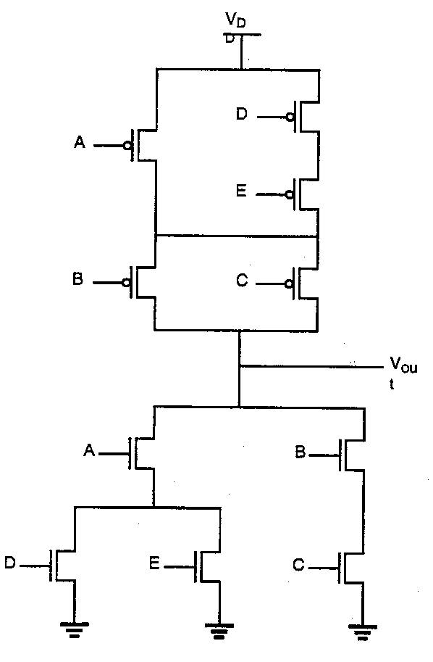
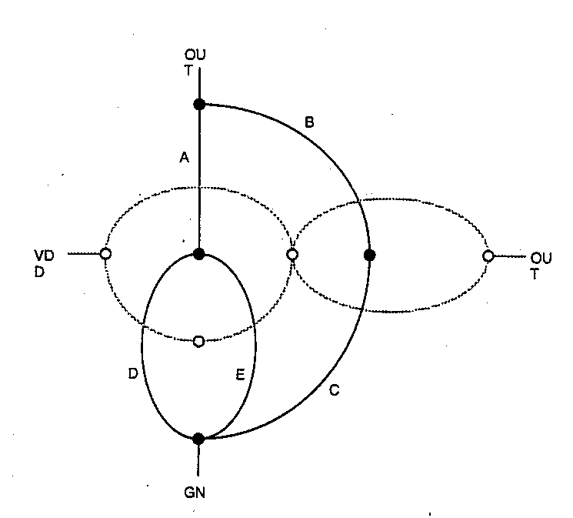
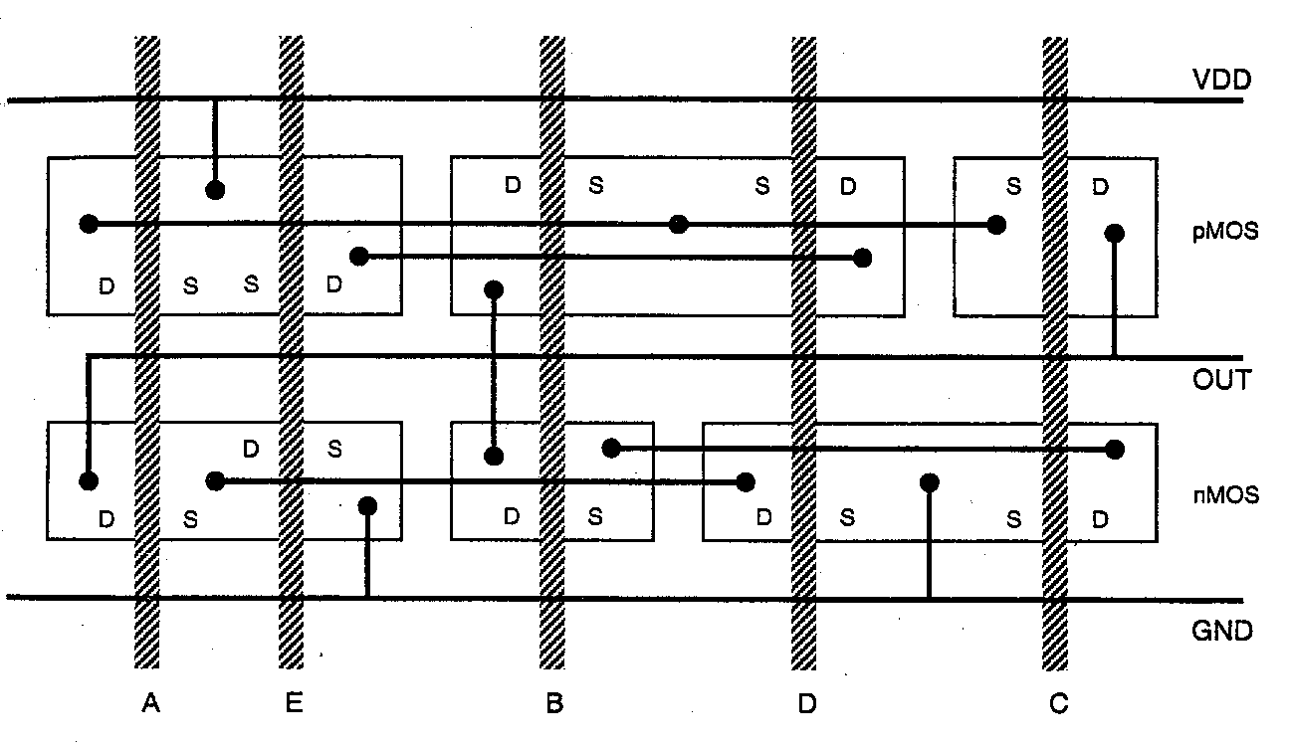
Layout Technique using Euler Graph Method
Euler Graph Technique can be used to determine if any complex CMOS gate can be physically laid out in an optimum fashion
  Start with either NMOS or PMOS tree (NMOS for this example) and connect lines for transistor segments, labeling devices, with vertex points as circuit nodes.
  Next place a new vertex within each confined area on the pull-down graph and connect neighboring vertices with new lines, making sure to cross each edge of the pull-down tree only once.
  The new graph represents the pull-up tree and is the dual of the pull-down tree.
The stick diagram at the left (done with arbitrary gate ordering) gives a very non-optimum layout for the CMOS gate above.
R. W. Knepper, SC571, page 5-16

Slide 17
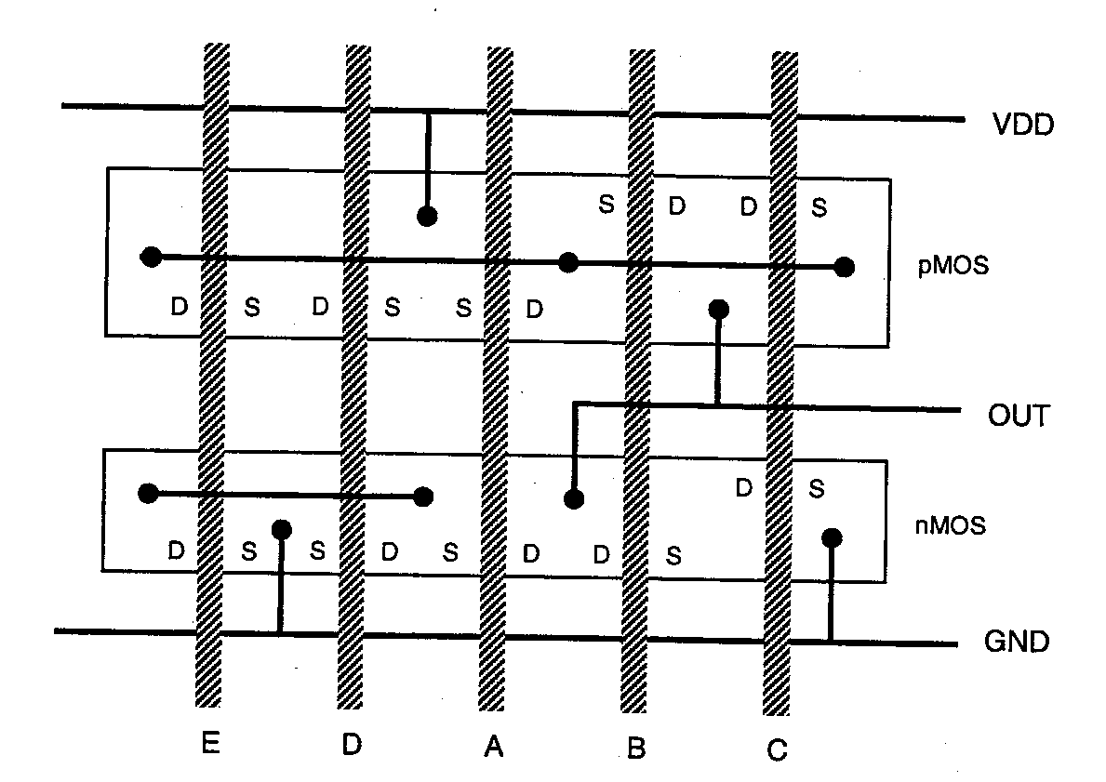
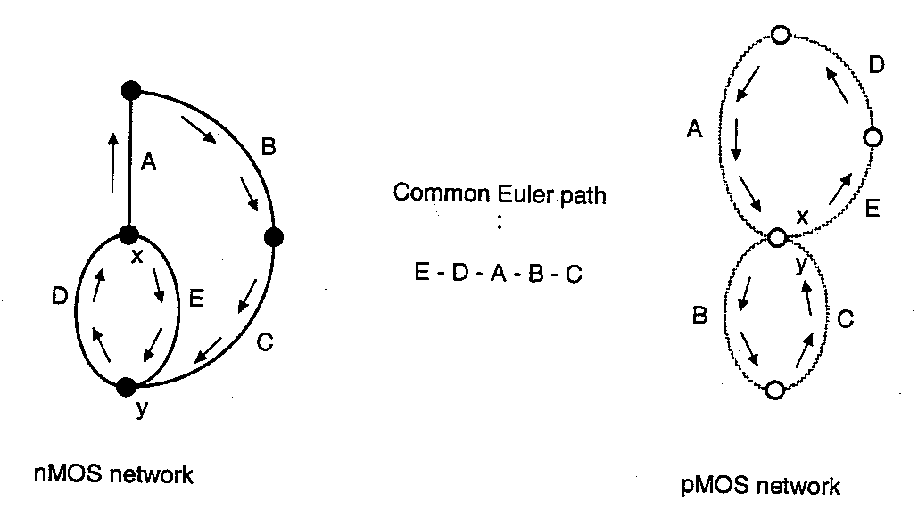
Layout with Optimum Gate Ordering
By using the Euler path approach to re-order the polysilicon lines of the previous chart, we can obtain an optimum layout.
Find a Euler path in both the pull-down tree graph and the pull-up tree graph with identical ordering of the inputs.
  Euler path: traverses each branch of the graph exactly once!
By reordering the input gates as E-D-A-B-C, we can obtain an optimum layout of the given CMOS gate with single actives for both NMOS and PMOS devices (below).
R. W. Knepper
SC571, page 5-17

Slide 18
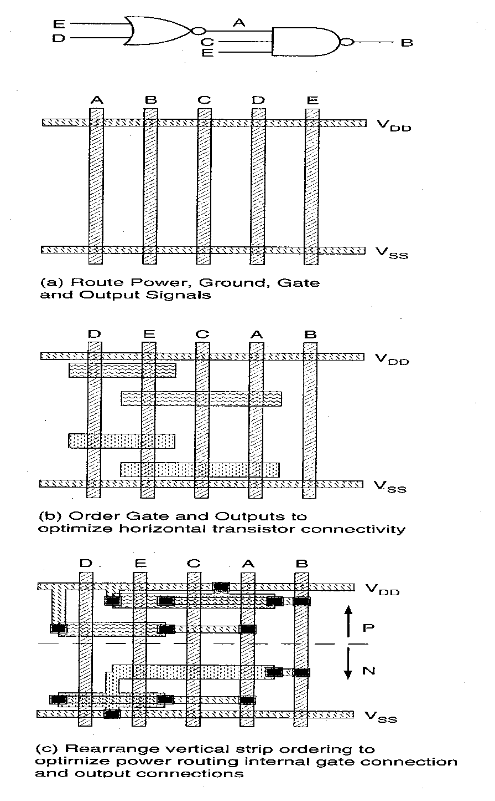
Automated Approach to CMOS Gate Layout
Place inputs as vertical poly stripes
Place Vdd and Vss as horizontal stripes
Group transistors within stripes to allow maximum source/drain connection
Allow poly columns to interchange in necessary to improve stripe wireability
Place device groups in rows
Wire up the circuit by using vertical diffusions for connections and manhattan metal routing (both horizontal and vertical)
R. W. Knepper
SC571, page 5-18

Slide 19
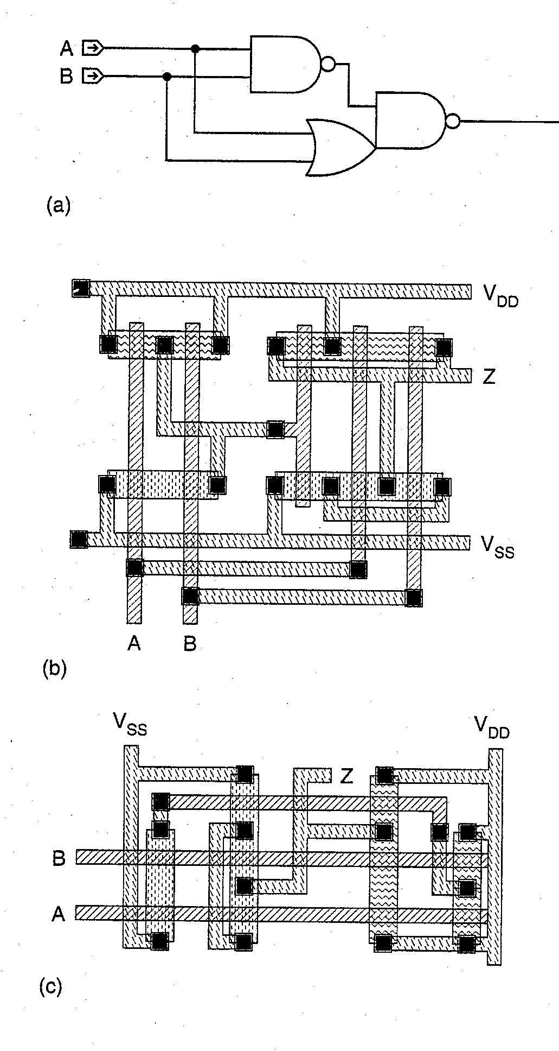
Complementary CMOS XNOR Gate Layouts
XNOR is an example of a complementary CMOS circuit where a single input is applied to the gates of multiple transistors in the N (and P) tree:
  Separate sections and stack transistors for each section over identical gate inputs
  XNOR implementation in (b) shows separate sections with X = (AB)’ and Z = ((A + B) X)’ = XNOR (A,B)
    Uses single row of N (and P) transistors with a break between the active regions
  Alternate layout in (c) uses vertical device regions perhaps making it a bit more compact
R. W. Knepper
SC571, page 5-19

Slide 20
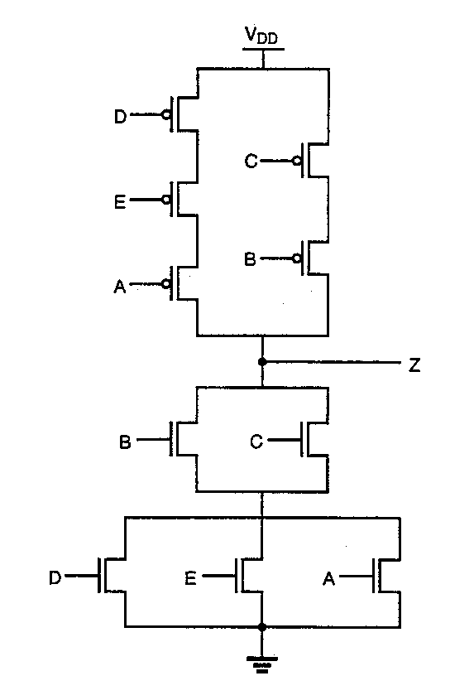
Euler Method Example: OAI Circuit Schematic
Use the Euler Method to layout the OAI circuit at the left.
  Can the circuit be laid out with optimum layout area?
    Single poly stripes
    Single active shapes
Method:
  Find NMOS network graph
  Find PMOS network graph
  Find a traverse of both graphs with a common Euler path
Answer on next chart!
R. W. Knepper
SC571, page 5-19a

Slide 21
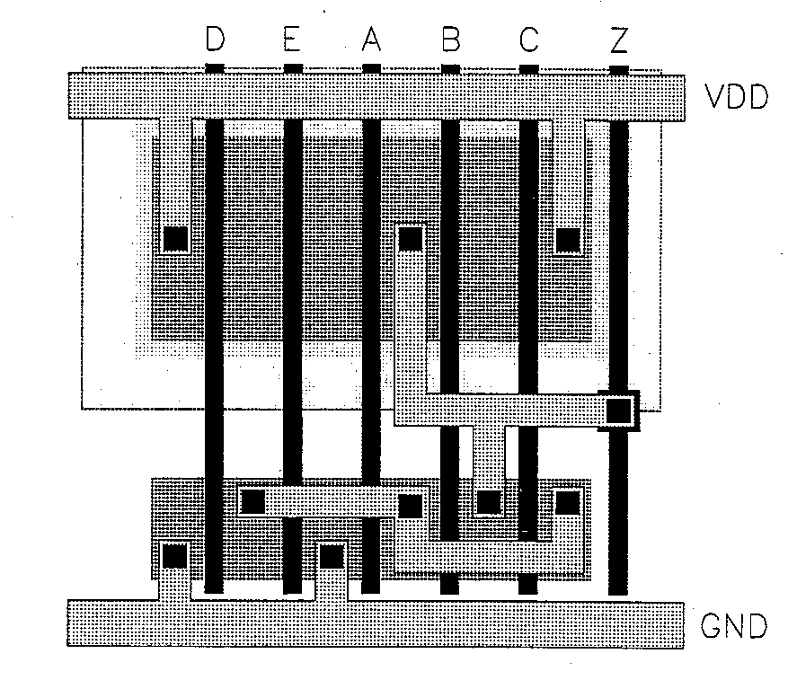
Example Layout: OAI Circuit of Chart 19a
The layout at the left is an optimum layout of the OAI circuit of chart 19a
  Single poly vertical inputs
  Unbroken single active regions for both N and P transistors
Problem: Find an equivalent inverter circuit for the layout at left assuming the following
  W/L)_{P} = 15 for all PMOS transistors
  W/L)_{N} = 10 for all NMOS transistors
R. W. Knepper
SC571, page 5-19b

Slide 22
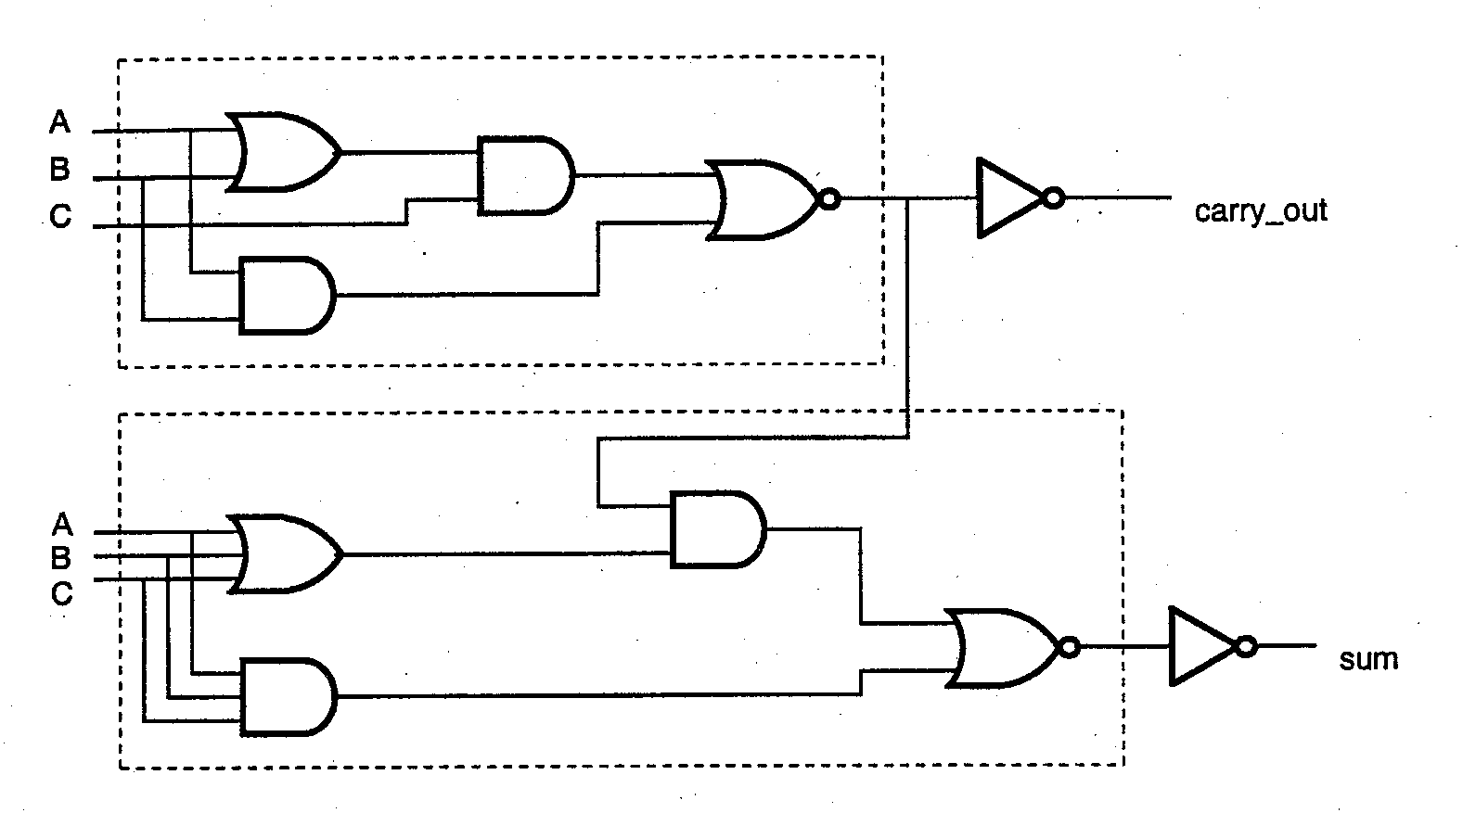
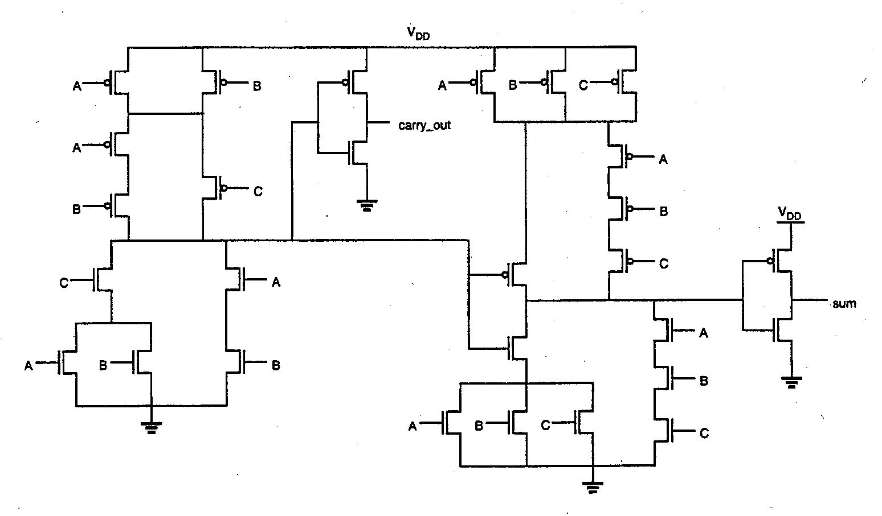
CMOS 1-Bit Full Adder Circuit
1-Bit Full Adder logic function:
  Sum = A XOR B XOR C
  = ABC + AB’C’ + A’BC’ + A’B’C
  Carry_out = AB + AC + BC
  Exercise: Show that the sum function can be written as shown at left
  Sum = ABC + (A + B + C) · carry_out’
This alternate representation of the sum function allows the 1-bit full adder to be implemented in complex CMOS with 28 transistors, as shown at left below.
  Carry_out’ internal node is used as an input to the adder complex CMOS gate
  Exercise: Show that the two P-trees in the complex CMOS gates of the carry_out and sum are optimizations of the proper dual derivations from the two N-tree networks.
R. W. Knepper
SC571, page 5-19c

Slide 23
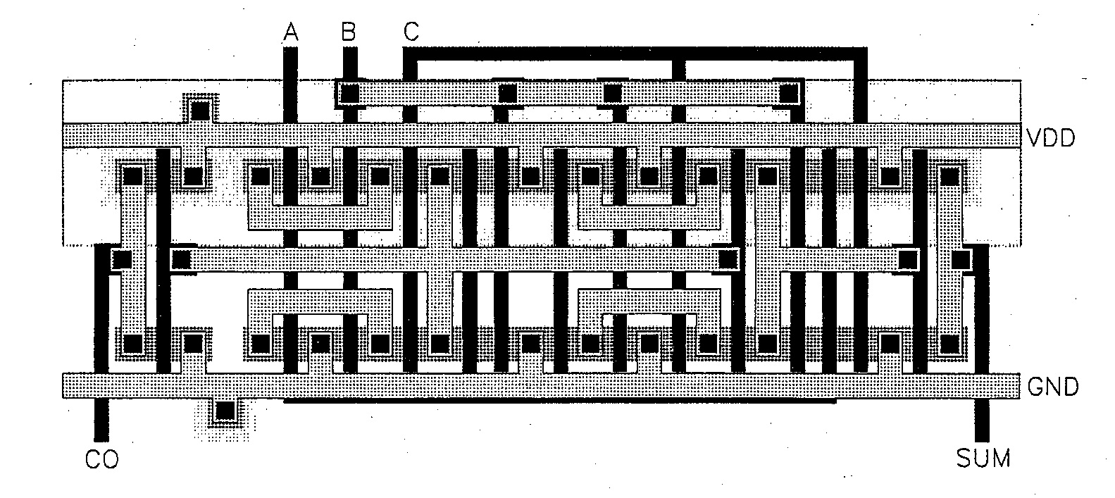
CMOS Full Adder Layout (Complex Logic)
Mask layout of 1-bit full adder circuit is shown below
  A layout designed with Euler method shows that the carry_out inverter requires separate active shapes, but all other N (and P) transistors were laid out in a single active region
  Layout below is non-optimized for performance
    All transistors are seen to be minimum W/L
Design of n-bit full adder:
  A carry ripple adder design uses the carry_out of stage k as the carry_in for stage k+1
  Typically the layout is modified from that shown below in order to use larger transistors for the carry_out CMOS gate in order to improve the performance of the ripple bit adder
    See Fig. 7.30 in Kang and Leblebici
R. W. Knepper
SC571, page 5-19d

Slide 24
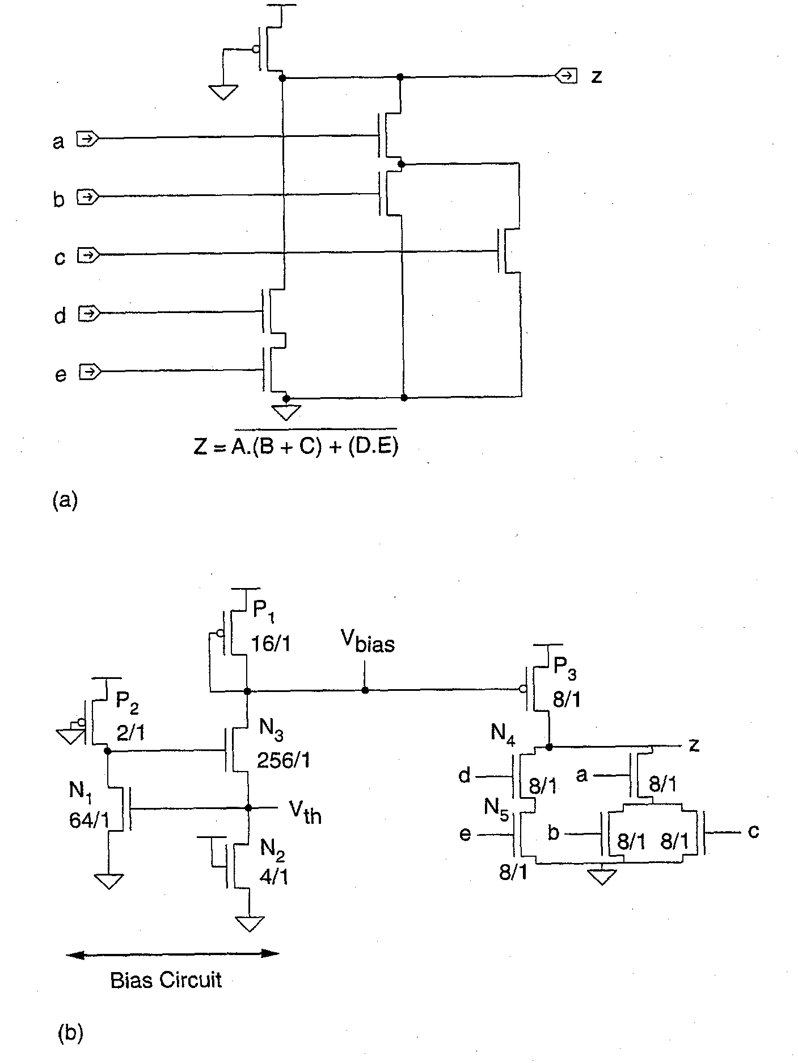
Pseudo-NMOS Logic
Pseudo-NMOS is a ratio circuit where dc current flows when the N pull-down tree is conducting.
  Must design the ratio of N devices W/L to P load device W/L so that when the N pull down leg with max resistance is conducting, the output is at a sufficiently low V_{OL}.
    e.g. for the logic shown in (a), the devices d & e would have a W/L roughly 6 times higher than the P load W/L
An alternate approach (shown in b) provides a bias voltage V_{bias} somewhat above ground for the P pull-up loads
  Allows the P load device ratio to be set equal to the N device W/L ratios for gate arrays and other applications where device options are limited
  V_{bias} ~= 1.6 volts in this circuit (for Vdd=5 volts)
R. W. Knepper
SC571, page 5-20

Slide 25
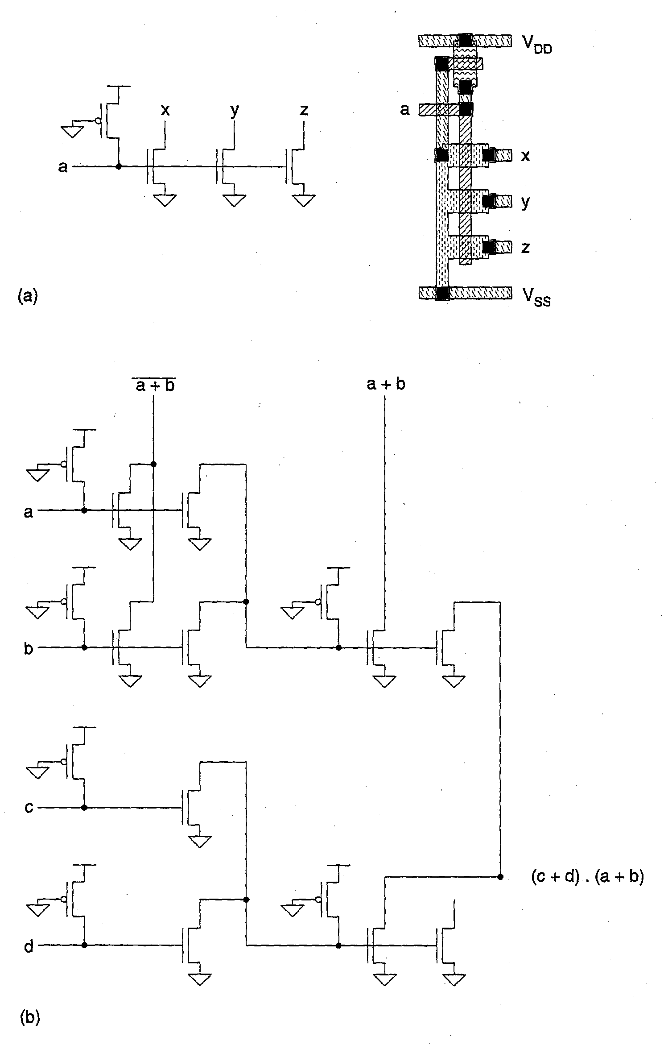
Variation of Pseudo-NMOS: Multi-Drain Logic
A version of Pseudo-NMOS called CMOS Multi Drain logic is shown at left.
  Electrically equivalent to Pseudo-NMOS
  Similar to outdated bipolar MTL (Merged Transistor Logic) or I²L (Integrated Injection Logic)
  Utilizes the open drain output configuration where the output devices are really part of the next stage logic
In Fig. (a) the standard basic gate is shown with its layout
In Fig (b) implementation of
  z = (a + b) · (c + d) is shown
  A circuit vertex, or dot, perhaps OR
  NMOS pull-down performs an invert
R. W. Knepper
SC571, page 5-21

Slide 26
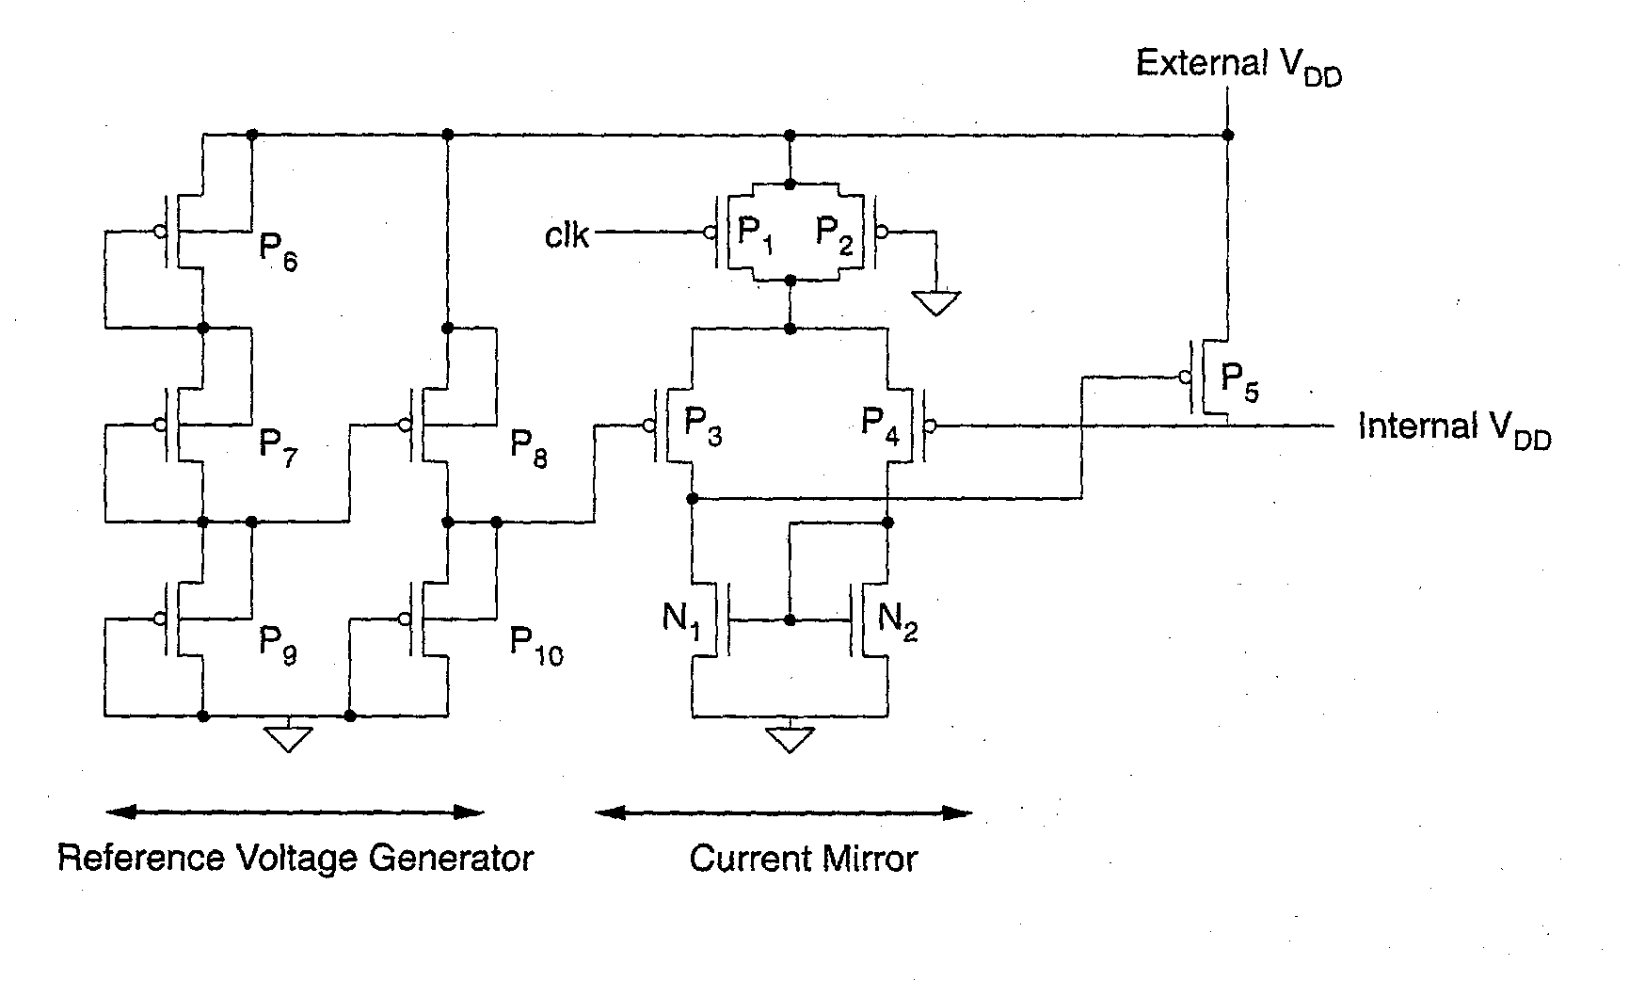
On-Chip Internal V_{DD} Generator
CMOS and Pseudo-NMOS circuitry often require an internally-generated Vdd supply voltage or a bias voltage (above Vss) for on-chip use
  Requirements:
    track supply voltages Vdd and Vss
    temperature compensation
    highly regulated
    de-coupled from power supply noise with use of on-chip capacitance
Circuit below utilizes a reference voltage generator comprised of series-connected saturated P devices feeding a current mirror to obtain Internal V_{DD} < External V_{DD}
  Clocked device P1 can be used to provide low power (sleep) mode with reduced Internal V_{DD}
R. W. Knepper
SC571, page 5-22

Slide 27
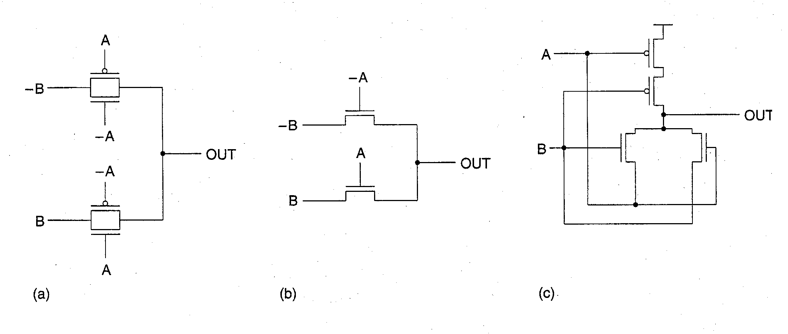
Complementary Pass-Transistor Logic (CPL)
Utilizes CMOS transmission gate (or just the single polarity version of TG) to perform logic
  Logical inputs may be applied to both the device gates as well as device source/drain regions
  Only a limited number of Pass Gates may be ganged in series before a clocked Pull-up (or pull-down) stage is required
(a) and (b) show simple XNOR implementation:
  If A is high, B is passed through the gate to the output
  If A is low, -B is passed through the gate to the output
(c) shows XNOR circuit including a cross-coupled input with P pull-up devices which does not require inverted inputs
R. W. Knepper
SC571, page 5-23

Slide 28
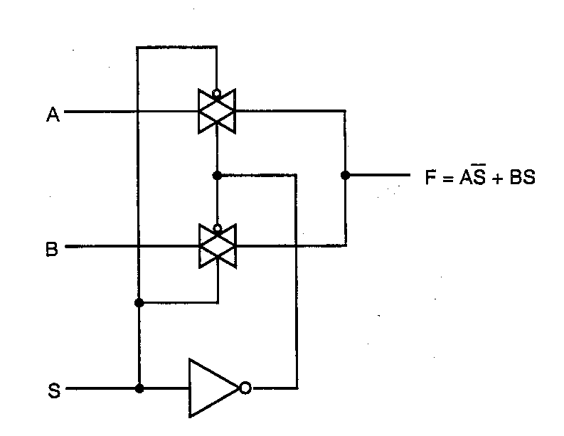
CMOS Transmission Gate Logic Design: 2-input MUX
CMOS Transmission Gates can be used in logic desig
  a savings in transistors is often realized (not always)
Operation:
  Three regions of operation (charging capacitor 0 to V_{DD})
    Region 1 (0 < Vout < |Vtp|) – both transistors saturated
    Region 2 (|Vtp| < Vout < V_{DD} – Vtn) – N saturated, P linear
    Region 3 (V_{DD} - Vtn < Vout < V_{DD}) – N cut-off, P linear
  Resistance of a CMOS transmission gate remains relatively constant (when both transistors are turned on) over the operating voltage range 0 to V_{DD}. (see previous homework)
    Using the formula for Region 3, we have
    Req = Req, p = 1/{β_{P}[(V_{DD} - |Vtp|) – ½ (V_{DD} – Vout)]}
    Use R_{eq} x C_{L} to do performance estimation where R_{eq} is the average resistance of the TG and C_{L} is the load capacitance
A 2-input multiplexor built with two CMOS transmission gates and an inverter is shown at the left.
  If S is high, input B is selected
  If S is low, input A is selected
R. W. Knepper
SC571, page 5-23a

Slide 29
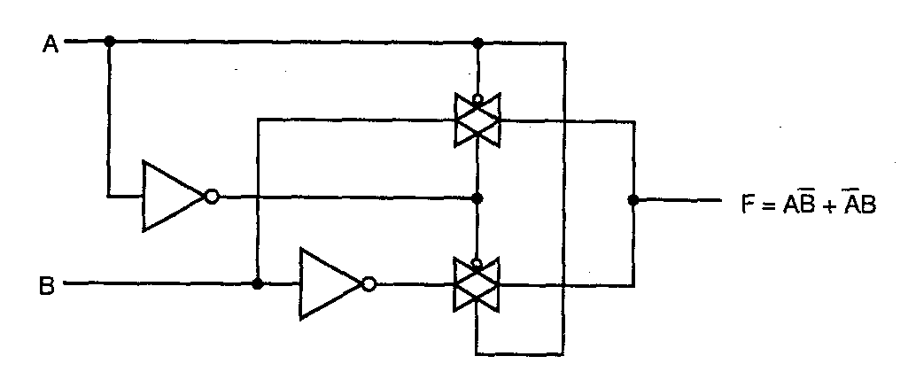
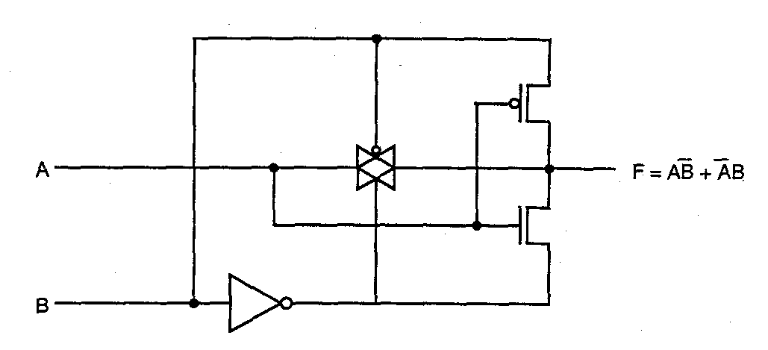
XOR Implementations using CMOS Transmission Gates
The top circuit implements an XOR function with two CMOS transmission gates and two inverters
  8 transistors total (4 fewer than a complex CMOS implementation)
The XOR can also be implemented with only 6 transistors with one transmission gate, one standard inverter, and one special inverter gate powered from B to B’ (instead of Vdd and Vss) and inserted between A and the output F.
R. W. Knepper
SC571, page 5-23b

Slide 30
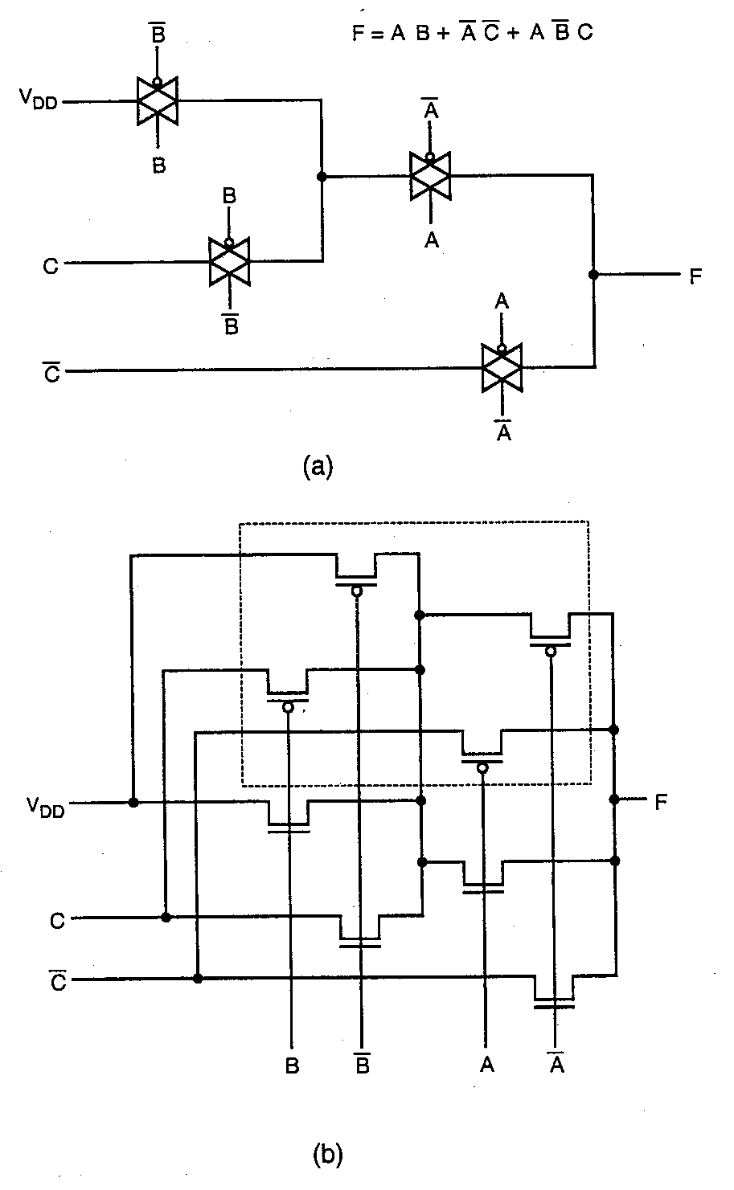
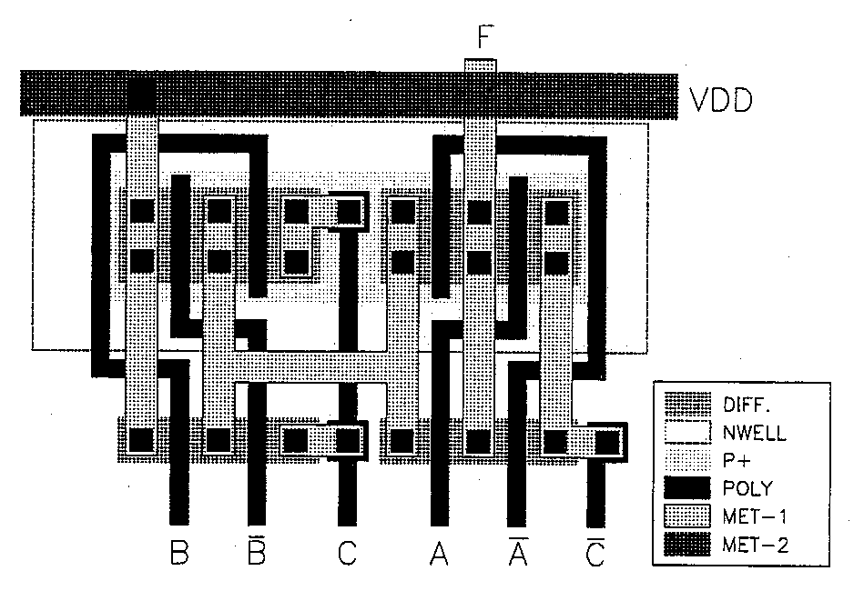
CMOS TG Realization of 3-Variable Boolean Function
An arbitrary 3-input Boolean function can be implemented as shown at left (a).
  14 transistors including inverters
  prevent high Z output for any logic cases
For optimum layout, group P and N transistors together as shown in (b).
  only one N-well is needed
Layout of the function is shown below.
  note poly input wiring congestion
R. W. Knepper
SC571, page 5-23c
Kang & Leblebici,
McGraw Hill, 1999

Slide 31
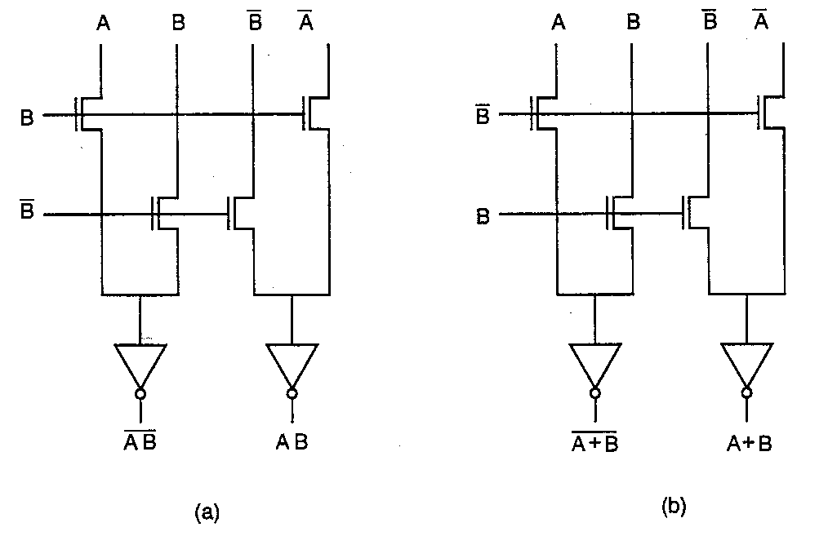
CMOS Pass-Transistor Logic (CPL): NAND & NOR
The complexity of CMOS pass-gate logic can be reduced by dropping the PMOS transistors and using only NMOS pass transistors (named CPL)
  In this case, CMOS inverters (or other means) must be used periodically to recover the full V_{DD} level since the NMOS pass transistors will provide a V_{OH} of VDD – V_{Tn} in some cases
The CPL circuit requires complementary inputs and generates complementary outputs to pass on to the next CPL stage
At the left, (a) is a 2-input NAND CPL circuit, (b) is a 2-input NOR CPL stage.
  Each circuit requires 8 transistors, double that required using conventional CMOS realizations
R. W. Knepper
SC571, page 5-23d

Slide 32
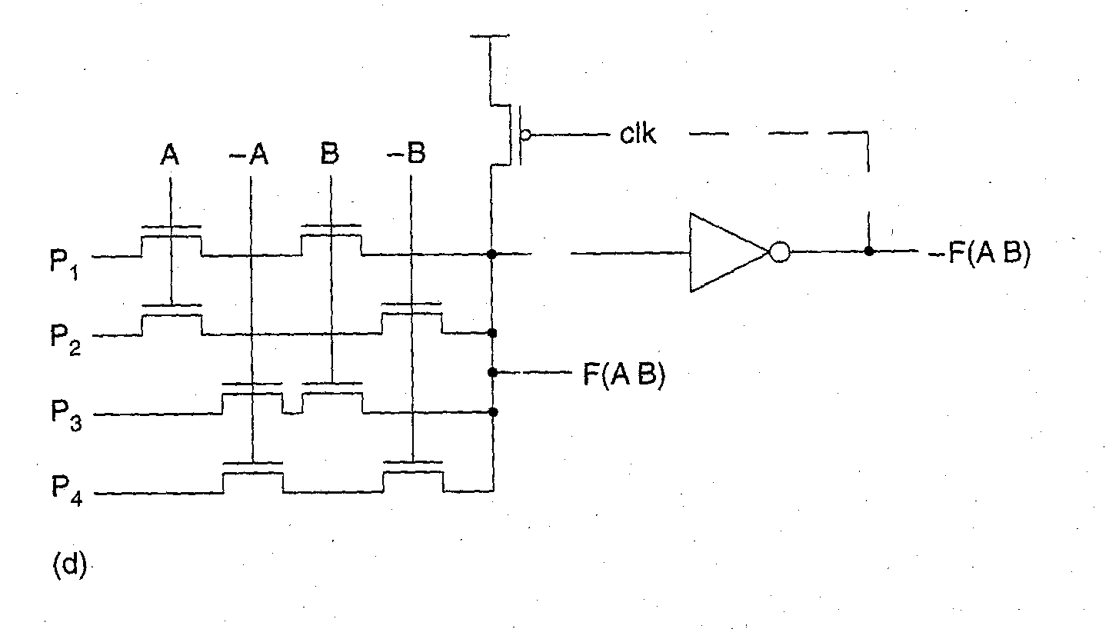
Boolean Function CPL Pass-Transistor Logic Gate
Pass-transistor logic gate can implement Boolean functions NOR, XOR, NAND, AND, and OR depending upon the P1-P4 inputs, as shown below.
  P1,P2,P3,P4 = 0,0,0,1 gives F(A,B) = NOR
  P1,P2,P3,P4 = 0,1,1,0 gives F(A,B) = XOR
  P1,P2,P3,P4 = 0,1,1,1 gives F(A,B) = NAND
  P1,P2,P3,P4 = 1,0,0,0 gives F(A,B) = AND
  P1,P2,P3,P4 = 1,1,1,0 gives F(A,B) = OR
Circuit can be operated with clocked P pull-up device or inverter-based latch
  Output inverter provides –F(A,B) and can be used to latch node F high (-F low)
R. W. Knepper
SC571, page 5-24

Slide 33
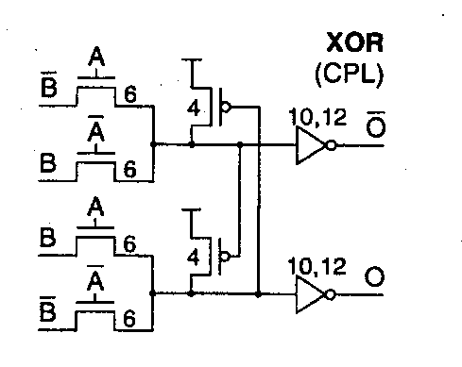
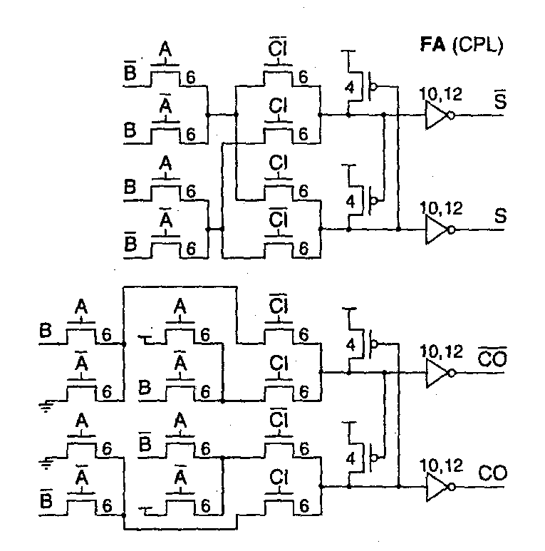
CMOS Pass-Transistor Logic: XOR & Full Adder
The XOR circuit shown at top-left contains a PMOS pull-up arrangement configured like a latch
  If XOR is true, the upper internal node goes high to VDD – VT while the lower internal node goes low to GND, thus causing the cross-coupled PMOS load devices to latch and pull the upper internal node all the way to VDD.
  If XOR is false, the opposite happens
  The inverters provide both true and complement outputs
At the bottom left is a 1-bit full adder CPL gate
  sum and carry_out are both provided in true and complement form
  Note the similarity of the sum function to the XOR above
  Both sum and carryout CPL gates contain the latching PMOS load configurations
Kang & Leblebici,
McGraw Hill, 1999
R. W. Knepper
SC571, page 5-24a

Slide 34
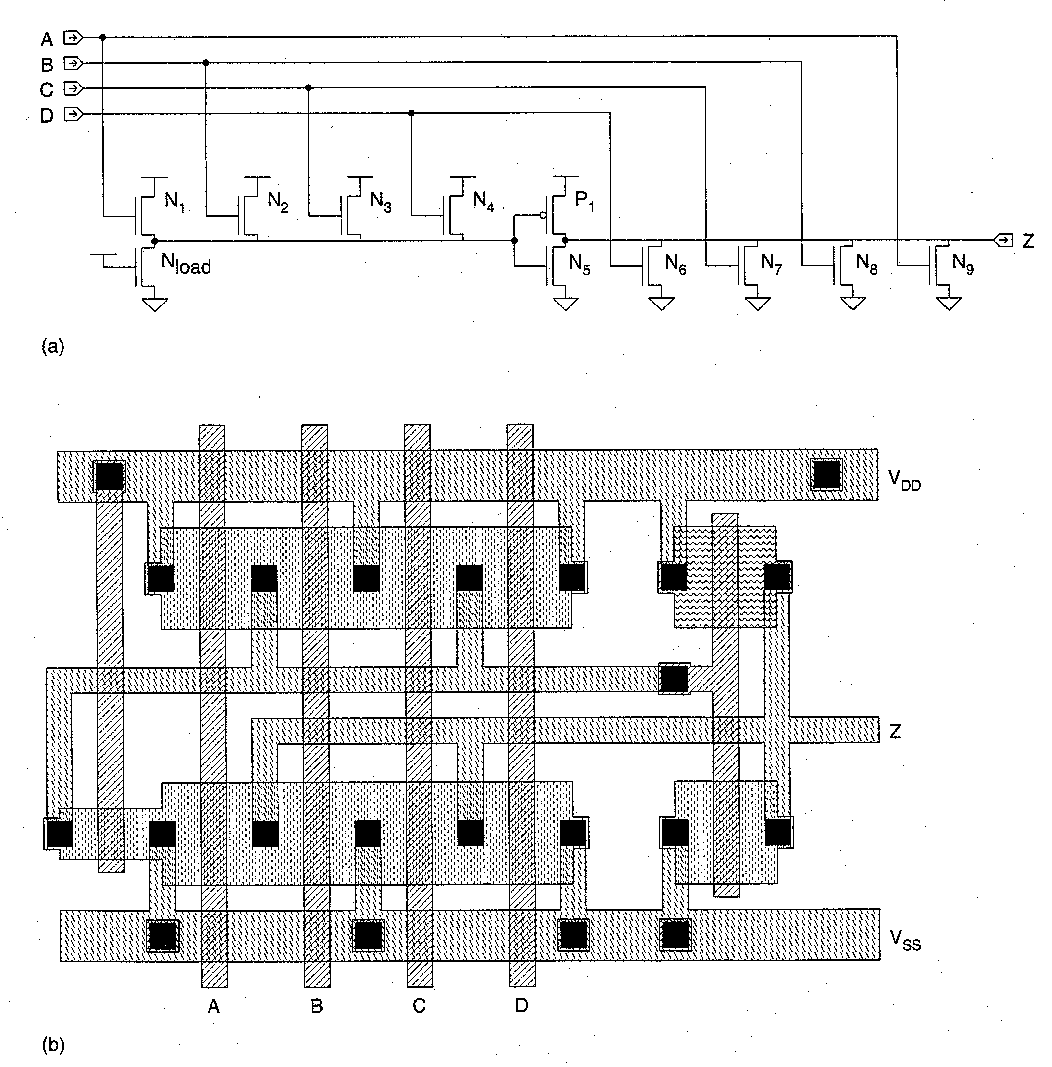
Source-Follower Pull-up Logic (SFPL)
SFPL is a variation on pseudo-NMOS whereby the load device is an N pull-down transistor and N source-follower pull-ups are used on the inputs.
  N pull-up transistors can be small limiting input capacitance
  N transistors are also duplicated as pull-down devices in order to improve the fall time
  Rise time is determined by the P1 inverter pull-up transistor when all inputs are low
SFPL is useful for high fan-in NOR logic gates
R. W. Knepper
SC571, page 5-25

Slide 35
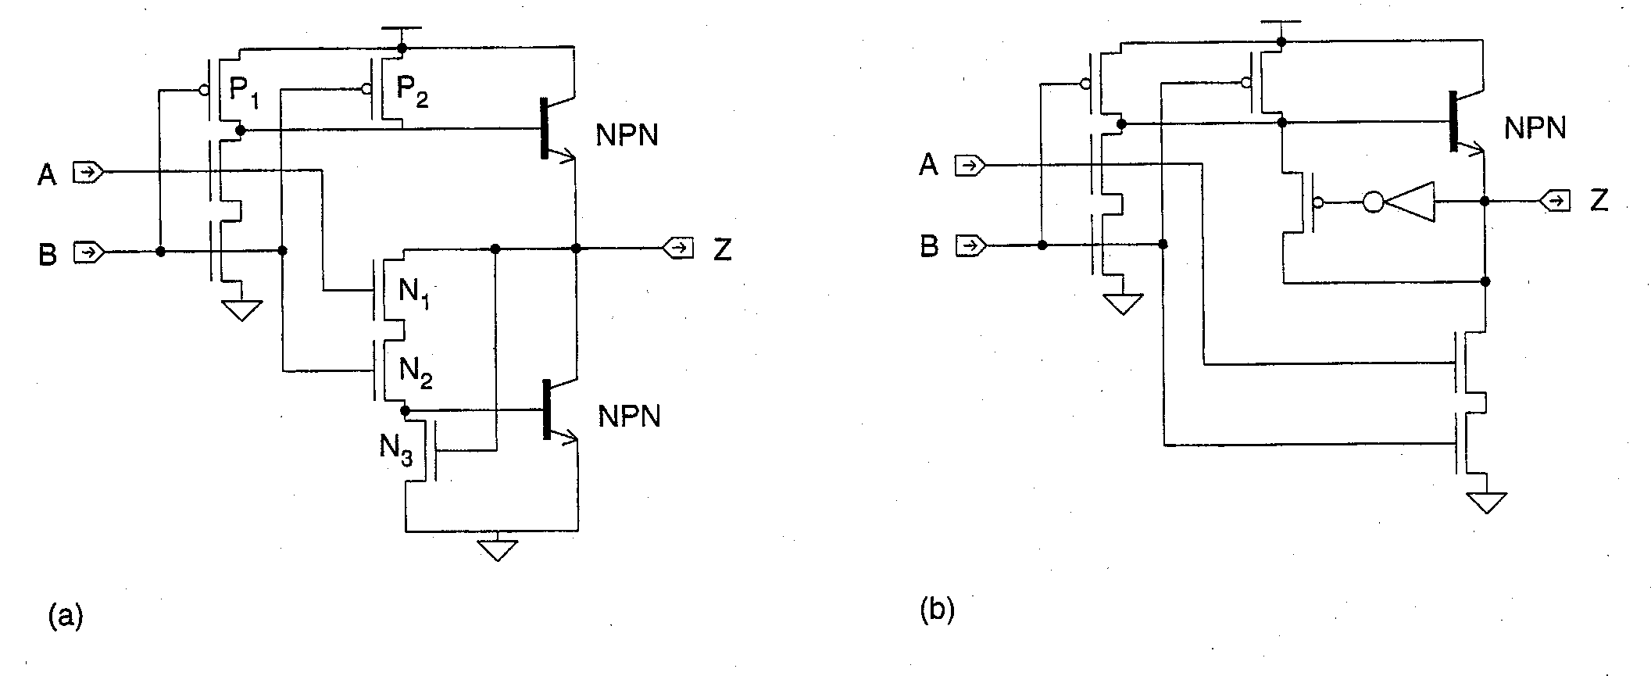
BICMOS Logic
BICMOS Logic is typically comprised of CMOS logic feeding a bipolar drive
  2-input NAND is shown below
N-tree pull down logic must be inserted twice:
  once in the actual CMOS logic circuit
  again in the base current path for the pull-down NPN transistor (N1 and N2)
N3 holds the pull-down NPN off when the output is pulling high
The circuit in (a) contains a V_{BE} drop on the output up-level (V_{OH} = V_{DD} – V_{BE})
V_{OL} is a V_{CEsat} which is a few hundred mV above ground
Feedback provided by the inverter in (b) pulls output V_{OH} all the way to V_{DD}
R. W. Knepper
SC571, page 5-26

